Slide 1
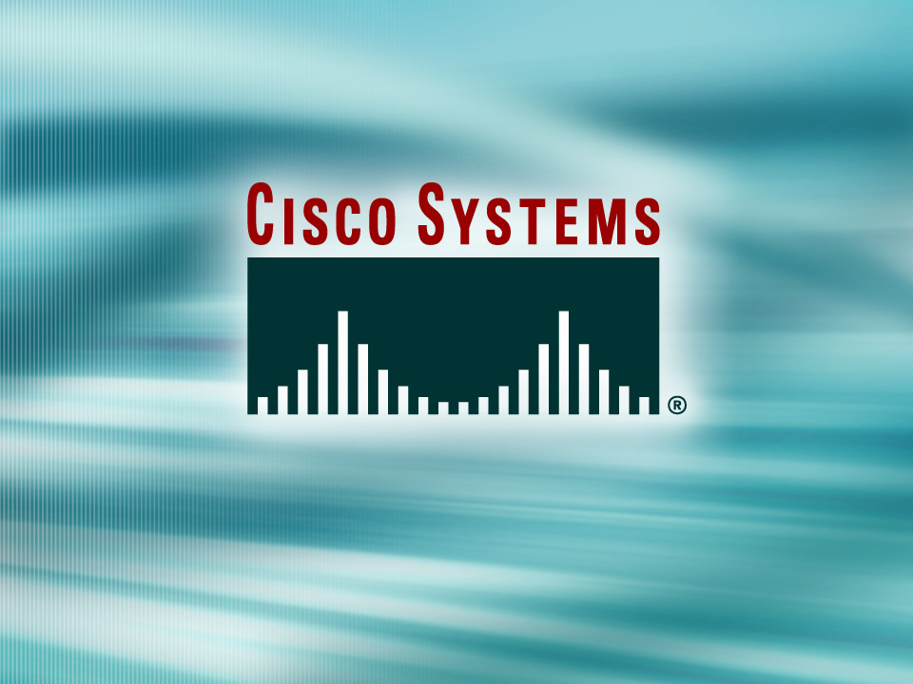
© 2002, Cisco Systems, Inc. All rights reserved.

Slide 2

Configuring a Catalyst Switch
© 2002, Cisco Systems, Inc. All rights reserved.
Notes:
Purpose: This chapter introduces the Cisco IOS™ CLI on the Catalyst® 1900 switch and router.
Timing: This chapter should take about 2 hours to present.
Note: The Catalyst 1900 switch only has a subset of the router Cisco IOS commands available.
Contents:
Introduction to Cisco IOS. Explain to the student what is IOS?
Cisco Device startup procedures in general.
IOS configuration source.
General introduction to the IOS CLI.
Cat 1900 switch startup procedures.
Intro to Cat 1900 CLI. This part covers the basic configuration on the switch, like setting the IP address and hostname. More details about the various Cat 1900 switch configuration commands are explained in Chapter 6 and 7.
Router startup procedures. More details on the router startup process is discussed in chapter 5.
Router IOS CLI.

Slide 3
Objectives
Upon completing this lesson, you will be able to:
  Verify the default configuration of the device, given a functioning access layer switch
  Configure the switch management IP address and the default gateway, given a functioning access layer switch and an IP addressing scheme
  Execute an add, move, or change on an access layer switch, given a new network requirement
Notes:
Slide 1 of 2
Purpose: This slide states the chapter objectives.
Emphasize: Read or state each objective so that each student has a clear understanding of the chapter objectives.
Note: Catalyst switches have different CLIs. The Catalyst 2900xl and the Catalyst 1900 has a Cisco IOS CLI. The Cisco IOS CLI commands available on the 2900xl is different from the 1900. The Catalyst 5000 family has no Cisco IOS CLI, and use the set commands instead. This class only covers the configuration on the Catalyst 1900 switch.

Slide 4
Catalyst 1900 and 2950 Default Configuration
  IP address: 0.0.0.0
  CDP: enabled
  100baseT port: autonegotiate duplex mode
  Spanning tree: enabled
  Console password: none
Notes:
Emphasize: The Catalyst 1900 comes with a factory default setting. Listed in the slide are just some of the default settings on the switch. A switch is plug-and-play to use for basic bridging functions.

Slide 5
Port Names on
Catalyst 1900 Switches
wg_sw_1900#show run
Building configuration...
Current configuration:
!
!
interface Ethernet 0/1
!
interface Ethernet 0/2
wg_sw_1900#show spantree
Port Ethernet 0/1 of VLAN1 is Forwarding
Port path cost 100, Port priority 128
Designated root has priority 32768, address 0090.8673.3340
Designated bridge has priority 32768, address 0090.8673.3340
Designated port is Ethernet 0/1, path cost 0
Timers: message age 20, forward delay 15, hold 1
wg_sw_1900#show vlan-membership
Port VLAN Membership Type Port VLAN Membership Type
------------------------------------------------------------------
1 5 Static 13 1 Static
2 1 Static 14 1 Static
3 1 Static 15 1 Static
Notes:
Slide 2 of 2
Purpose: Use this slide to explain that the ports on the 1900 switch are refer to as port as well as interface.

Slide 6
Port Names on
Catalyst 2950 Switches
wg_sw_2950#show run
Building configuration...
Current configuration:
!
!
interface FastEthernet0/1
!
interface FastEthernet0/2
wg_sw_2950#show spantree
Interface Fa0/1 (port 7) in Spanning tree 1 is FORWARDING
Port path cost 19, Port priority 128
Designated root has priority 32768, address 0008.a445.c980
Designated bridge has priority 32768, address 0008.a445.c980
Designated port is 7, path cost 0
Timers: message age 0, forward delay 0, hold 0
BPDU: sent 8316, received 4
wg_sw_2950#show vlan
VLAN Name Status Ports
---- -------------------------------- --------- -------------------------------
1 default active Fa0/1, Fa0/2, Fa0/3, Fa0/4,
Fa0/5, Fa0/6, Fa0/7, Fa0/8,
Fa0/9, Fa0/10, Fa0/11, Fa0/12,
Fa0/13, Fa0/14, Fa0/15, Fa0/16,
Fa0/17, Fa0/18, Fa0/19, Fa0/20,
Fa0/21, Fa0/22, Fa0/23, Fa0/24
Notes:
Slide 2 of 2
Purpose: Use this slide to explain that the ports on the 1900 switch are refer to as port as well as interface.

Slide 7
Configuring the
Switch IP Address
Catalyst 1900
wg_sw_1900(config)#ip address {ip_address} {mask}
Configures an IP address and subnet mask on the switch
wg_sw_1900(config)#ip address 10.5.5.11 255.255.255.0
Catalyst 2950
wg_sw_2950(config-if)#ip address {ip_address} {mask}
Configures an IP address and subnet mask for the switch VLAN1 interface
wg_sw_2950(config)#interface vlan 1
wg_sw_2950(config-if)#ip address 10.5.5.11 255.255.255.0
Notes:
Layer 2 of 2
Emphasize: Explain to the students why a Layer 2 switch requires an IP address.

Slide 8
Configuring the Switch Default Gateway
wg_sw_a(config)# ip default-gateway {ip address}
Configures the switch default gateway for the Catalyst 1900 and 2950 switches
wg_sw_a(config)#ip default-gateway 10.5.5.3
Notes:
Layer 2 of 2
Note: By default, RIP is enabled on the Catalyst 1900 switch. This enables the switch to automatically learn the default gateway IP address by listening to the RIP updates.
To disable this feature, the command is as follows:
wg_sw_a(config)#no rip
wg_sw_a(config)#end
wg_sw_a#sh ip
IP Address: 10.1.1.10
Subnet Mask: 255.255.255.0
Default Gateway: 0.0.0.0
Management VLAN: 1
Domain name:
Name server 1: 0.0.0.0
Name server 2: 0.0.0.0
HTTP server : Enabled
HTTP port : 80
RIP : Disabled

Slide 9
Showing the Switch IP Address
Catalyst 1900
wg_sw_1900#show ip
IP address: 10.5.5.11
Subnet mask: 255.255.255.0
Default gateway: 10.5.5.3
Management VLAN: 1
…
wg_sw_a#
Catalyst 2950
wg_sw_2950#show interface vlan 1
Vlan1 is up, line protocol is up
Hardware is Cat5k Virtual Ethernet, address is 0010.f6a9.9800 (bia 0010.f6a9.9800)
Internet address is 172.16.80.79/24
Broadcast address is 255.255.255.255
. . .
wg_sw_2950#
Notes:
Note: The command to set the DNS server address is as follows:
wg_sw_a(config)#ip name-server ?
A.B.C.D IP Address

Slide 10
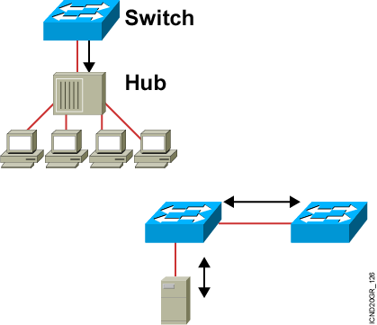
Duplex Overview
Half Duplex (CSMA/CD)
Unidirectional data flow
Higher potential for collision
Hubs connectivity
Full Duplex
Point-to-point only
Attached to dedicated switched port
Requires full-duplex support on both ends
Collision-free
Collision detect circuit disabled
Notes:
Slide 2 of 2
Emphasize: Full duplex is for point-to-point connections only. A Fast Ethernet full-duplex connection provides a throughput of 200 Mbps (100 Mbps per direction).
Note:

Slide 11
Setting Duplex Options
Catalyst 1900
wg_sw_1900(config)#interface e0/1
wg_sw_1900(config-if)#duplex {auto | full |
full-flow-control | half}
Catalyst 2950
wg_sw_2950(config)#interface fe0/1
wg_sw_2950(config-if)#duplex {auto | full | half}
Notes:
Emphasize: “Half” is the default on the Ethernet ports.

Slide 12
Showing Duplex Options
Switch#show interfaces fastethernet0/3
FastEthernet0/3 is up, line protocol is down
Hardware is Fast Ethernet, address is 0000.0000.0003 (bia 0000.0000.0003)
MTU 1500 bytes, BW 100000 Kbit, DLY 100 usec,
reliability 255/255, txload 1/255, rxload 1/255
Encapsulation ARPA, loopback not set
Keepalive set (10 sec)
Half-duplex, 10Mb/s
input flow-control is off, output flow-control is off
ARP type: ARPA, ARP Timeout 04:00:00
Last input never, output never, output hang never
Last clearing of "show interface" counters never
Queueing strategy: fifo
Output queue 0/40, 0 drops; input queue 0/75, 0 drops
5 minute input rate 0 bits/sec, 0 packets/sec
5 minute output rate 0 bits/sec, 0 packets/sec
0 packets input, 0 bytes, 0 no buffer
Received 0 broadcasts, 0 runts, 0 giants, 0 throttles
0 input errors, 0 CRC, 0 frame, 0 overrun, 0 ignored
0 input packets with dribble condition detected
0 packets output, 0 bytes, 0 underruns
0 output errors, 0 collisions, 2 interface resets
0 babbles, 0 late collision, 0 deferred
0 lost carrier, 0 no carrier
0 output buffer failures, 0 output buffers swapped out
Notes:
Emphasize: The show interfaces command will display the duplex status.
FCS errors and late collision errors are discussed in a later slide.

Slide 13
Managing the MAC Address Table
wg_sw_1900#show mac-address-table
Number of permanent addresses : 0
Number of restricted static addresses : 0
Number of dynamic addresses : 6
Address Dest Interface Type Source Interface List
------------------------------------------------------------------
00E0.1E5D.AE2F Ethernet 0/2 Dynamic All
00D0.588F.B604 FastEthernet 0/26 Dynamic All
00E0.1E5D.AE2B FastEthernet 0/26 Dynamic All
0090.273B.87A4 FastEthernet 0/26 Dynamic All
00D0.588F.B600 FastEthernet 0/26 Dynamic All
00D0.5892.38C4 FastEthernet 0/27 Dynamic All
Catalyst 1900
wg_sw_2950#show mac-address-table
Dynamic Address Count: 1
Secure Address Count: 0
Static Address (User-defined) Count: 0
System Self Address Count: 25
Total MAC addresses: 26
Maximum MAC addresses: 8192
Non-static Address Table:
Destination Address Address Type VLAN Destination Port
------------------- ------------ ---- --------------------
0050.0f02.3372 Dynamic 1 FastEthernet0/2
Catalyst 2950
Notes:
Layer 2 of 2
Note: The 1900en maximum MAC address table size is 1024. Once the table is full, it will flood all new addresses until existing entries age out.
The command to change the MAC address table aging time is as follows:
wg_sw_a(config)#mac-address-table aging-time ?
<10-1000000> Aging time value
The default is 300 sec.
The MAC address table is also referred to as the CAM table (Content Address Memory) on some switches.

Slide 14
Setting a Permanent MAC Address
Catalyst 1900 and 2950
wg_sw_1900(config)#mac-address-table permanent {mac-address type module/port}
wg_sw_1900(config)#mac-address-table permanent 2222.2222.2222 ethernet 0/3
wg_sw_1900#show mac-address-table
Number of permanent addresses : 1
Number of restricted static addresses : 0
Number of dynamic addresses : 4
Address Dest Interface Type Source Interface List
------------------------------------------------------------------
00E0.1E5D.AE2F Ethernet 0/2 Dynamic All
2222.2222.2222 Ethernet 0/3 Permanent All
00D0.588F.B604 FastEthernet 0/26 Dynamic All
00E0.1E5D.AE2B FastEthernet 0/26 Dynamic All
00D0.5892.38C4 FastEthernet 0/27 Dynamic All
Catalyst 2950 only
wg_sw_2950(config)#mac-address-table static
mac_addr {vlan vlan_id} [interface int1 [int2 ... int15]]
Notes:
Layer 3 of 3
Emphasize: Permanent addresses do not age out.

Slide 15
Setting a Restricted Static MAC Address on the Catalyst 1900
wg_sw_1900(config)#mac-address-table restricted static
{mac-address type module/port src-if-list}
wg_sw_1900(config)#mac-address-table restricted static 1111.1111.1111 e0/4 e0/1
wg_sw_1900#show mac-address-table
Number of permanent addresses : 1
Number of restricted static addresses : 1
Number of dynamic addresses : 4
Address Dest Interface Type Source Interface List
------------------------------------------------------------------
1111.1111.1111 Ethernet 0/4 Static Et0/1
00E0.1E5D.AE2F Ethernet 0/2 Dynamic All
2222.2222.2222 Ethernet 0/3 Permanent All
00D0.588F.B604 FastEthernet 0/26 Dynamic All
00E0.1E5D.AE2B FastEthernet 0/26 Dynamic All
00D0.5892.38C4 FastEthernet 0/27 Dynamic All
Notes:
Layer 3 of 3
Emphasize: A static address is a permanent address that does not age out. The static address allows you to restrict which ports can send traffic to it.

Slide 16
Setting a Restricted Static MAC Address on the Catalyst 2950
wg_sw_2950(config)#mac-address-table secure
hw-addr interface [vlan vlan-id]
wg_sw_2950#mac-address-table secure 0003.3333.3333 fa 0/1 vlan 1
wg_sw_2950#show mac-address-table
Dynamic Address Count: 1
Secure Address Count: 1
Static Address (User-defined) Count: 1
System Self Address Count: 25
Total MAC addresses: 28
Maximum MAC addresses: 8192
Non-static Address Table:
Destination Address Address Type VLAN Destination Port
------------------- ------------ ---- --------------------
0050.0f02.3372 Dynamic 1 FastEthernet0/2
0003.3333.3333 Secure 1 FastEthernet0/1
Static Address Table:
Destination Address VLAN Input Port Output Ports
------------------- ---- ---------- -----------------------
2222.2222.2222 1 ALL Fa0/1
Notes:
Layer 3 of 3
Emphasize: A static address is a permanent address that does not age out. The static address allows you to restrict which ports can send traffic to it.

Slide 17
Configuring Port Security
Catalyst 1900
wg_sw_1900(config-if)#port secure [max-mac-count count]
wg_sw_1900(config)#interface e0/4
wg_sw_1900(config-if)#port secure
wg_sw_1900(config-if)#port secure max-mac-count 1
Catalyst 2950
wg_sw_2950(config-if)#port security max-mac-count count
wg_sw_2950(config)#interface fa0/1
wg_sw_2950(config-if)#port security
wg_sw_2950(config-if)#port security max-mac-count 10
Notes:
Layer 2 of 2
Note: When the switch-sticky learns a MAC address on a secured port, the switch will make that MAC address a permanent address.

Slide 18
Verifying Port Security
on the Catalyst 1900
wg_sw_1900#show mac-address-table security
wg_sw_1900#show mac-address-table security
Action upon address violation : Suspend
Interface Addressing Security Address Table Size
---------------------------------------------------------------
Ethernet 0/1 Disabled N/A
Ethernet 0/2 Disabled N/A
Ethernet 0/3 Disabled N/A
Ethernet 0/4 Enabled 1
Ethernet 0/5 Disabled N/A
Ethernet 0/6 Disabled N/A
Ethernet 0/7 Disabled N/A
Ethernet 0/8 Disabled N/A
Ethernet 0/9 Disabled N/A
Ethernet 0/10 Disabled N/A
Ethernet 0/11 Disabled N/A
Ethernet 0/12 Disabled N/A
wg_sw_1900(config)#address-violation {suspend | disable | ignore}
Notes:
Layer 2 of 2
Emphasize: The default action is “suspend.”

Slide 19
Verifying Port Security
on the Catalyst 2950
wg_sw_2950#show mac-address-table secure
wg_sw_2950#show mac-address-table secure
Non-static Address Table:
Destination Address Address Type VLAN Destination Port
------------------- ------------ ---- --------------------
0003.3333.3333 Secure 1 FastEthernet0/1
wg_sw_2950(config-if)#port security action {shutdown | trap}
wg_sw_2950#show port-security
Notes:
Layer 2 of 2
Emphasize: The default action is “suspend.”

Slide 20
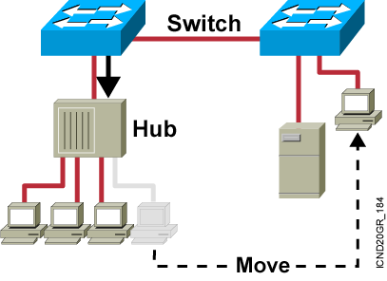
Executing Adds, Moves, and Changes for MAC Addresses
Adding a MAC Address
Configure port security.
Configure the MAC address.
Changing a MAC Address
Remove MAC address restrictions.
Moving a MAC Address
Add the address to a new port.
Configure port security on the
new switch.
Configure the MAC address to the
port allocated for the new user
Remove the old port configuration.

Slide 21
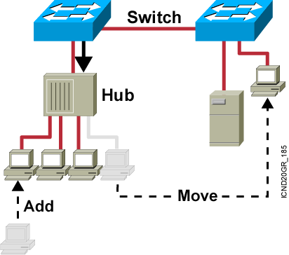
Adding a New Switch to the Network
Determine the IP address for management purposes.
Configure administrative access for the console, auxiliary, and virtual terminal (VTY) interfaces.
Configure security for the device.
Configure the access switch ports as necessary.

Slide 22
Managing the Configuration File
Catalyst 1900
wg_sw_1900#copy nvram tftp://host/dst_file
wg_sw_1900#copy tftp://host/src_file nvram
wg_sw_1950#copy nvram tftp://10.1.1.1/wgswd.cfg
Configuration upload is successfully completed
wg_sw_1950#copy tftp://10.1.1.1/wgswd.cfg nvram
TFTP successfully downloaded configuration file
Catalyst 2950
wg_sw_2950#copy startup-config tftp://host/dst_file
Notes:
Layer 3 of 3

Slide 23
Clearing NVRAM
Catalyst 1900
wg_sw_1900#delete nvram
Resets the system configuration to factory defaults
Catalyst 2950
wg_sw_2950#erase startup-config
Resets the system configuration to factory defaults
Notes:
Note: This is equivalent to the router Cisco IOS CLI erase start command.

Slide 24
Summary
  A Catalyst switch comes with factory default settings that can be displayed with the show command.
  To configure an IP address and subnet mask on a switch, use the ip address command. To configure a default gateway, use the ip default-gateway command.
  Half-duplex transmission uses collision detection. The faster full-duplex mode is used for directly connected devices where collision detection isn’t needed.
  Use the duplex command to configure switch duplex options.
  MAC address tables include dynamic, permanent, and static addresses. Use the mac-address-table command to set permanent and static addresses.
Notes:
Purpose: This slide discuss the initial configurations on the routers and switches.
Note: There is no setup mode on the Catalyst 1900 switch.

Slide 25
Summary (Cont.)
  Use the mac-address-table restricted static command
  to associate a restricted static address with a particular port.
  Secured ports restrict the use of a port to a user-defined group of stations, set with the port secure command.
  As your network endpoint topology changes by adding new devices or interfaces, or moving or changing existing ones, you may need to modify the switch configuration.
  The copy command can be used to copy a configuration from or to a file server, while the delete nvram command resets the switch configuration to the factory default settings.
Notes:
Purpose: This slide discuss the initial configurations on the routers and switches.
Note: There is no setup mode on the Catalyst 1900 switch.

Slide 26
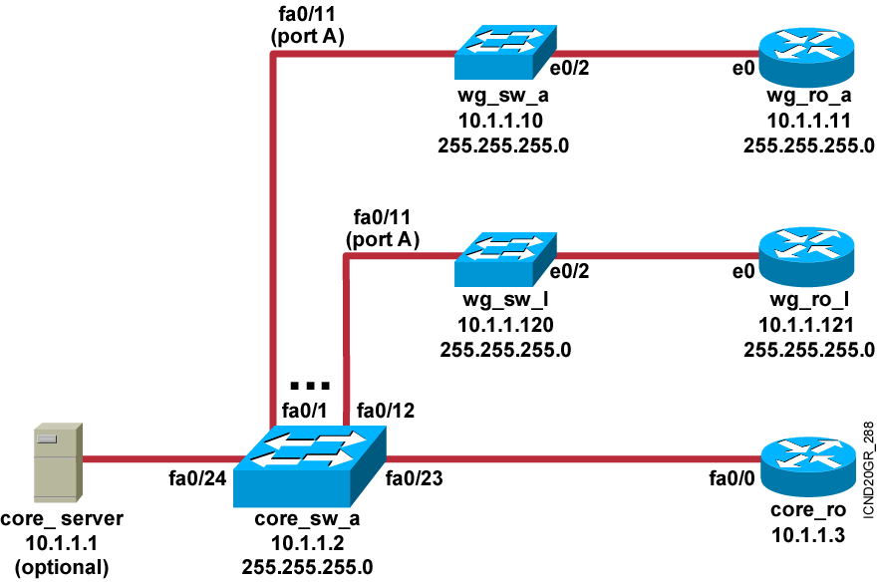
Visual Objective 3-1:
Configuring the Switch
Pod Switch Router Ethernet
A 10.1.1.10 10.1.1.11
B 10.1.1.20 10.1.1.21
C 10.1.1.30 10.1.1.31
D 10.1.1.40 10.1.1.41
E 10.1.1.50 10.1.1.51
F 10.1.1.60 10.1.1.61
G 10.1.1.70 10.1.1.71
H 10.1.1.80 10.1.1.81
I 10.1.1.90 10.1.1.91
J 10.1.1.100 10.1.1.101
K 10.1.1.110 10.1.1.111
L 10.1.1.120 10.1.1.121
Notes:
Lab ?
Missing link core_ro ------core_sw_a. Fixed, kcm.

Slide 27


